Slide 1


Overview

Slide 2
Agenda
What is Splunk?
Splunk Versions & OS Supported
What does Splunk do?
What does Splunk Provide ?
Data Source
Delivering Operational Intelligence

Slide 3
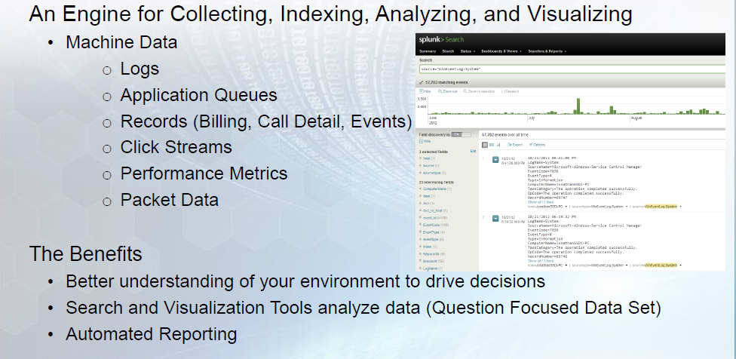
What is Splunk?
Notes:
But not me
☹
It is too slow
Can you hear me

Slide 4
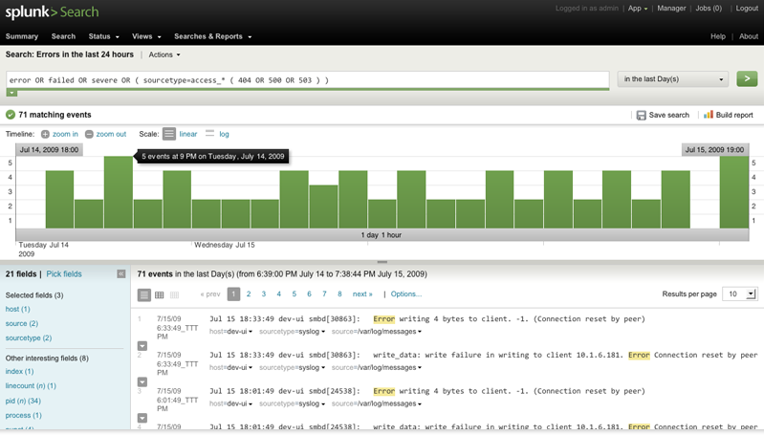
Continued…..
Search and analysis engine
Google like search of your log data

Slide 5
Versions
Free
  500MB/day
  Reporting
  Ad-hoc search
Enterprise (all above and)
  500MB/day and more!
  Access controls
  Distributed Search, Load Balancing
  Monitoring & Alerting

Slide 6
OS Supported
Windows (32 & 64-bit)
Linux
Solaris
OSX
FreeBSD
AIX
HP-UX

Slide 7
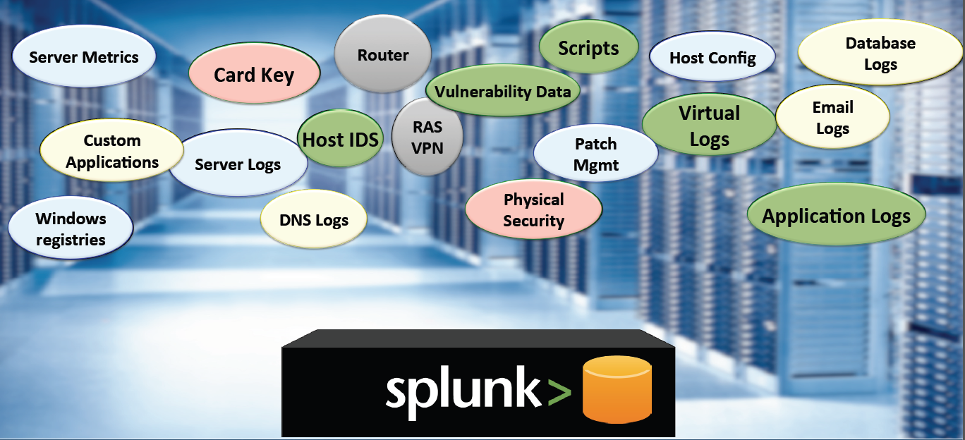
What does Splunk do?

Slide 8
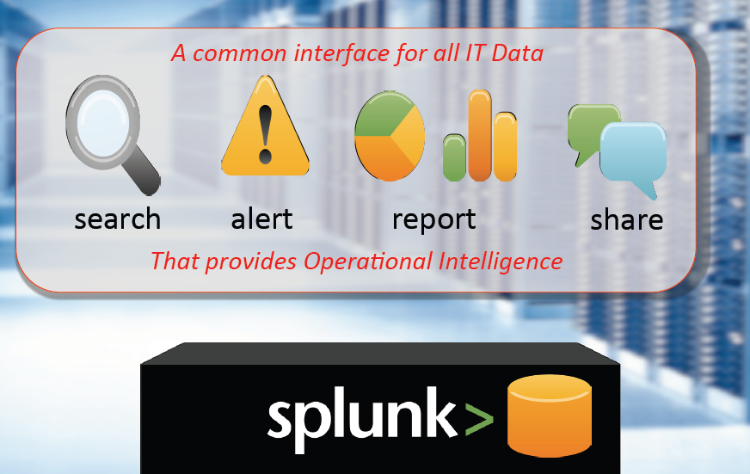
What does Splunk Provide?

Slide 9
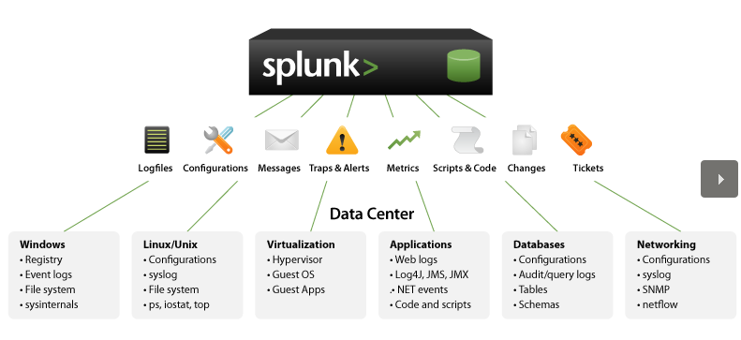
Data Sources

Slide 10
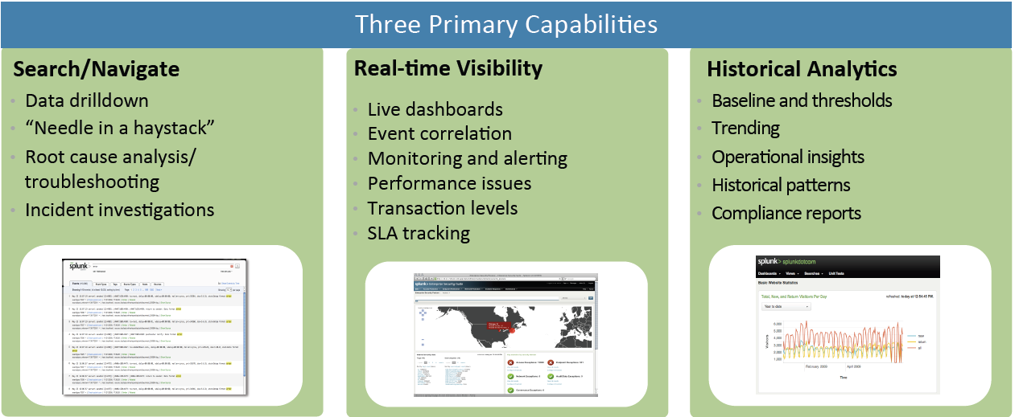
Delivering Operational Intelligence

